Slide 1
Analysis of hospital based ayurvedic clinical practice to gain real world data knowledge
Vinay Mahajan
Guides:
Dr. Ashwini Godbole, Dr. Girish Tillu, Dr. Ashwini Mathur
Notes:
Micro as well as macro level analysis is possible
Zoom in and zoom out
Possible usages:
1. Clinical Research
2. Pricing and Market Access
3. Pre-Approval Communication and Scientific Exchange
4. Promotional Interactions and Content
5. Fees for Service
6. Interactions with Patients and Patient Organizations
7. External training
The ADSL data useful for:
This has not been done since 2011 in the hospital as well as this kind of analysis has not taken place in Ayurvedic area.
Individual patient comprehensive view –
Covering all diseases reported as per visit
Corresponding medicines prescribed
Corresponding services prescribed
Covering complete In patient and Out patient information for the patient
Has been generated.
A subset of patients experiencing similar diseases is possible,
A subset of patients prescribed with a specific medicine is possible.
Complicated combinations of patients having certain diseases reported before and after certain diseases is possible.
Similar combinations of treatments
Patient ID is not present in each domain, but patient visit is used as the primary key [may be a suboptimal way to set-up the database]
RMSD patients visit the hospital premises more often than that of the metabolic patients.
More out patient visits compared to in patient visits.

Slide 2
Agenda
Background and supporting research
Examples of Real World Data
Need of the study
Methods
Study aims objectives and design
Data analysis design
Accessing and understanding real life data
Summary of methods
Results
Clinical data understanding
Demographics and Patient specific factors
Diagnostics and Interventions
Conclusions
Ongoing / future work

Slide 3
Analysis of hospital based Ayurvedic clinical practice to gain real world data knowledge
PI-1 Name | Dr. Ashwini Godbole
PI-2 Name | Vinay Mahajan
Co PI Name | Dr. Prasan Shankar Dr. Poornima Devkumar
Study Centre | IAIM hospital
Place of work | University of Trans-disciplinary Health Sciences and Technology
Advisors | Dr. Girish Tillu Dr. Ashwini Mathur

Slide 4
Background and Previous supporting research

Slide 5
Use of Real world data in pharmaceutical industry (1/3)
Explosion of data types and volumes
Electronic media (EHR)
Mobile devices
Wearables
Sensor data
Use of
Technology
Cutting edge analytical tools
Allow
Better design
Greater in-depth view of data as never before
Since 1998:
27 (<5% of all) drug approvals by major Health authorities (US FDA, EMA, PMDA, Health Canada)
Increasing evidence of use of “naturally reported data” in drug approvals in modern biomedicine
https://www.sciencedirect.com/science/article/pii/S0149291820301338 : Study: Clarivate Analytics, USA (2019)
Maissenhaelter, BE, Woolmore, AL, Schlag, PM. Real-world evidence research based on big data: motivation-challenges-success factors. Onkologe (Berl). 2018;24(suppl 2):91-98.

Slide 6
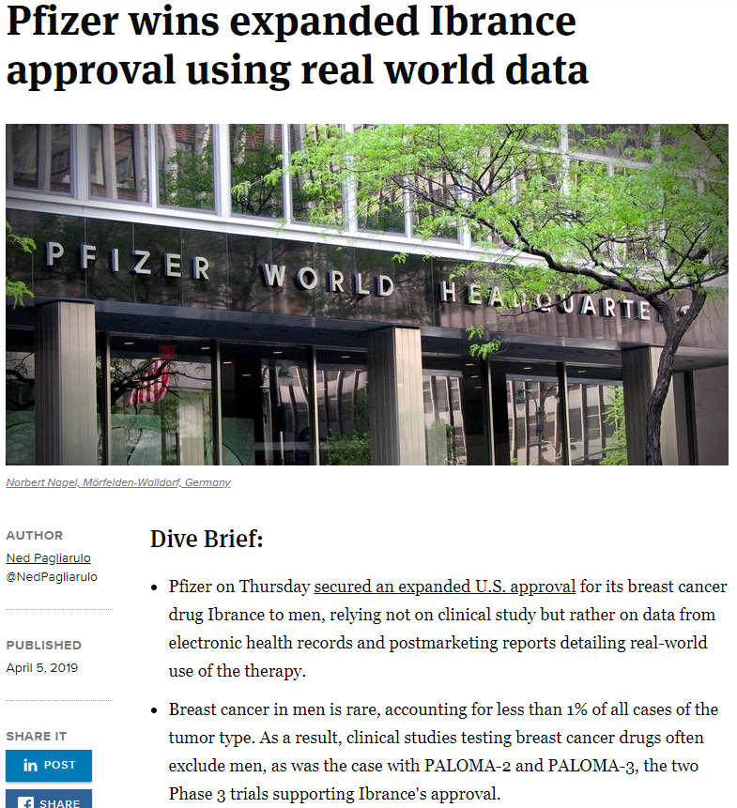
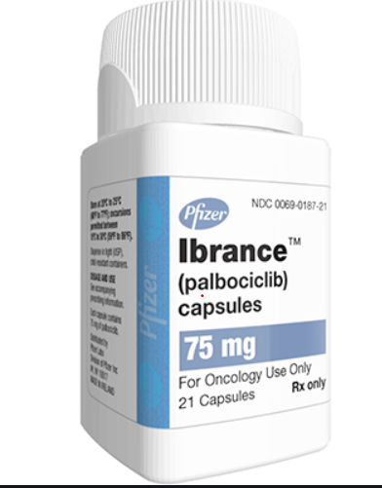
Use of Real world data in pharmaceutical industry (2/3)
https://www.google.com/url?sa=i&url=https%3A%2F%2Fwww.empr.com%2Fdrug%2Fibrance%2F&psig=AOvVaw3XbC_oNQivQ22-FXsjzmmA&ust=1602667142686000&source=images&cd=vfe&ved=0CAIQjRxqFwoTCPjRgMiesewCFQAAAAAdAAAAABAD
https://www.biopharmadive.com/news/pfizer-wins-expanded-ibrance-approval-using-real-world-data/552135/#:~:text=Pfizer%20on%20Thursday%20secured%20an,world%20use%20of%20the%20therapy.

Slide 7
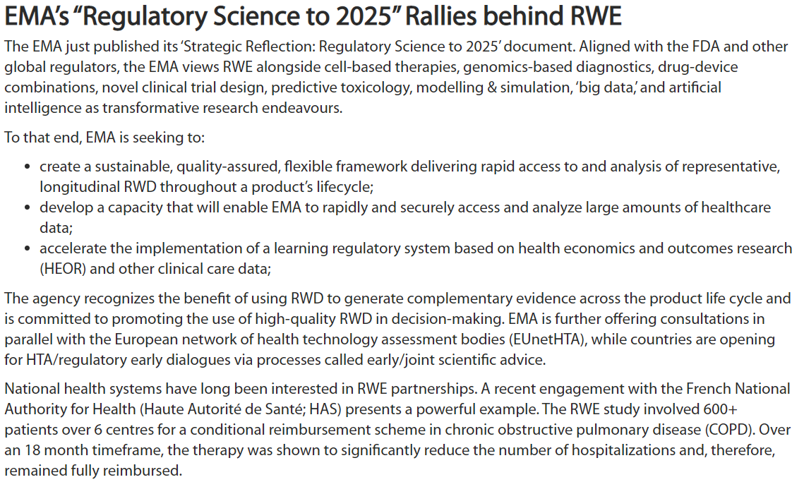
Use of Real world data in pharmaceutical industry (3/3)
https://pharmaboardroom.com/articles/real-world-evidence-from-market-access-to-drug-approval/
Franklin, Jessica & Schneeweiss, Sebastian. (2017). When and How Can Real World Data Analyses Substitute for Randomized Controlled Trials?. Clinical Pharmacology & Therapeutics. 102. 10.1002/cpt.857

Slide 8
Need of the study
Ayurveda and its development:
Conceptual developments: everyday observations and basic laws of nature (real world experience)
Necessary adjustments as per the passage of time based on observations and experiences (real world experience)
Ayurveda is practiced more in clinics (real world experience) than in clinical research setting,
No artificial restrictions
on usage of medicines
duration of treatment or
type of patients to treat
A big challenge in a protocol driven clinical trial setting
Data
Data
Data
Pioneering effort and new contributions: as this kind of work was never done in ayurvedic area
Based on imminent thought leaders in the field of ayurveda

Slide 9
Methods

Slide 10
Study Aims and Objectives
Aims: To generate real world evidence in the field of ayurveda by using tools and techniques like visual analytics and deep learning methods
Objectives:
Converting clinical life data into analyzable format
Clinical data understanding
Studying demographics and patient specific factors
Diagnostics and treatment data
Outcome and effect
Based on discussions with guides

Slide 11
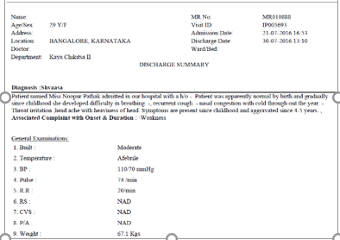
From a patient to ...
TDU - IAIM Hospital database Bengaluru
Data version: 2011 to Oct 2017
Reasonably large Ayurvedic electronic databases operational since 2011
Total number of patients treated more than 50,000
Out patients = ~45,000
In patients = ~7,000 (* some patients are both Out patient / in patient)
~1,70,000 out patient visits
Patients from more than 50 countries
More than 900 disease conditions treated,
More than 3000 medicines / services recorded
Implementation of Ayurvedic Clinical Dictionary for diagnosis
Operational insights
Clinical insights
New research ideas
Based on Real world experience
Stakeholders
Hospital management
Clinicians, and patients
Universities and learning institutes
Policy makers
Healthcare providers
Girish Tillu Ayurveda: From Diagnosis to Health [Slidedeck presented at TDU].
Ayurvedic disease classification dictionary (ACD) -Dictionary developed at the University, and CDAC, Pune
TDU – IAIM Hospital database
AyuSoft data, developed by CDAC Pune

Slide 12
Data flow
Assigned Medical Record Department (MRD) person will help in extracting the data in anonymized format
The existing database contains sensitive information related to individual patients. All the efforts will be made to protect sensitive information like
Name of patient,
Full address,
Phone numbers,
Socio economic status, etc.
This information will not be extracted from source data in order to maintain confidentiality and the patient cannot be traced back and contacted.
Based on discussions with the medical directors and guides

Slide 13
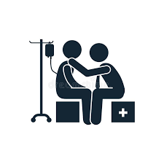




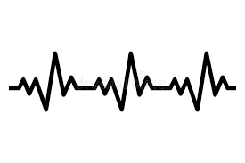
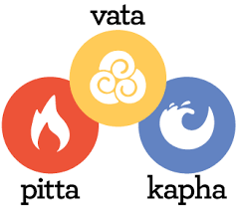
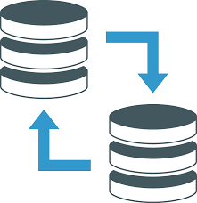
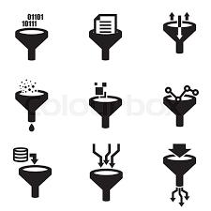

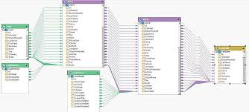
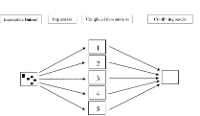
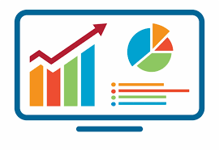

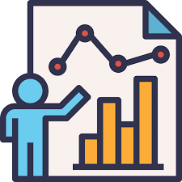

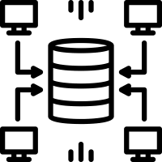

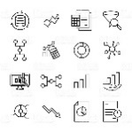



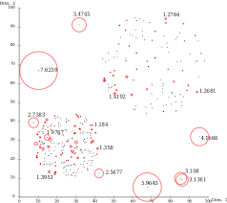
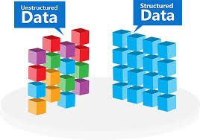

Flow diagram
Data
Knowledge
Wisdom
Hospital visit | Assessments | Electronic Medical health record
Data Sources | Staging area | Ware house | Data marts | Usage
Data access: |  |  |  | Hospital management Researchers Health authorities Various documents Data mining
Operational system Coding dictionaries Clinical system Flat files information | Calculations and transformations | Curated and consistent data storage | Operational data Pharmacy data Patient level data
Own idea + pictures taken from Google searches

Slide 14


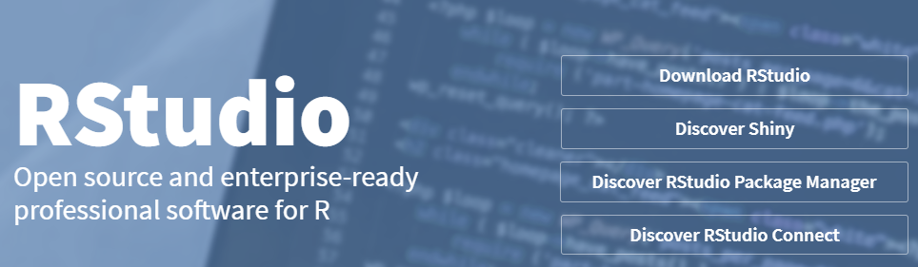
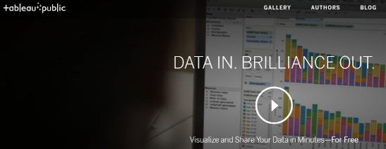

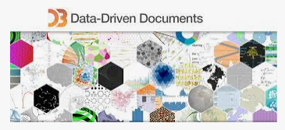
Data observations into summaries, stories – technologies used

Slide 15
Data collection tables in the source database (150+ tables out of 800)
action_rights | diet_prescribed | hospital_technical | package_componentdetail | patient_registration | section_field_options | store_item_batch_details | test_details
admission | discharge_format_detail | icu_bed_charges | package_item_charges | patient_section_details | service_consumable_usage | store_item_details | test_org_details
anesthesia_type_charges | doctor_charges_backup | ip_bed_details | package_prescribed | patient_section_details_orig | service_documents | store_item_lot_details | test_results_master
area_master | doctor_charges_op_backup | ip_prescription | patient_activities | patient_section_forms | service_master_charges | store_patient_indent_details | test_visit_report_signatures
bed_details | doctor_consultation | item_supplier_prefer_supplier | patient_consultation_field_values | patient_section_image_details | service_master_charges_backup | store_patient_indent_main | test_visit_reports
bill | doctor_consultation_charge | manf_master | patient_demographics_mod | patient_section_values | service_org_details | store_po | tests_conducted
bill_activity_charge | doctor_medicine_favourites | medicine_dosage_master | patient_deposits | patient_service_prescriptions | services | store_po_main | tests_prescribed
bill_adjustment | doctor_op_consultation_charge | medicine_id_health_authority_unique | patient_deposits_setoff_adjustments | patient_test_prescriptions | services_prescribed | store_reagent_usage_details | theatre_charges
bill_charge | doctor_org_details | message_recipient | patient_details | ppfv_form_detail_id | stk_chkpt | store_reagent_usage_main | u_user
bill_charge_adjustment | dyna_package_category_limits | mrd_casefile_attributes | patient_details_patient_phone_country_code | preauth_prescription | stock_issue_details | store_reorder_levels | url_action_rights
bill_receipts | dyna_package_charges | mrd_codes_doctor_master | patient_discharge | preauth_prescription_activities | stock_issue_main | store_retail_customers | user_services_depts.
complaintslog | dyna_package_org_details | mrd_codes_master | patient_documents | prescribed_medicines_master | store_adj_details | store_sales_details | visit_vitals
consultation_charges | equipement_charges | mrd_diagnosis | patient_general_docs | progress_notes | store_adj_main | store_sales_main | vital_reading
consultation_org_details | estimate_bill | mrd_observations | patient_hvf_doc_values | registration_charges | store_checkpoint_details | store_stock_details
deposit_setoff_total | estimate_charge | operation_charges | patient_medicine_prescriptions | sample_collection | store_estimate_details | store_transaction_lot_details
diagnostic_charges | favourite_reports | operation_org_details | patient_other_medicine_prescriptions | sch_resource_availability | store_grn_details | store_transfer_details
diagnostic_charges_backup | fixed_asset_master | other_services_prescribed | patient_other_prescriptions | sch_resource_availability_details | store_grn_main | store_transfer_main
diagnostic_reagent_usage | follow_up_details | outsource_sample_details | patient_packages | scheduler_appointment_items | store_indent_details | supp_inv_id
diagnostics | growth_chart_reference_data | pack_org_details | patient_pdf_form_doc_values | scheduler_appointments | store_indent_main | supplier_master
diet_charges | ha_item_code_type | package_charges | patient_prescription | screen_rights | store_invoice | temp_stock_item_batch_with_diff_mrp_expdt
TDU hospital database

Slide 16
Data observations into summaries, stories
Generic algorithm and steps followed
Use R program to generate tabular or graphical analysis
Use source tables from the SQLserver
Use SQL queries to combine necessary tables
Use R program to create analysis data tables
150+ tables in SQL
25+ tables used for calculations
13 tables converted
6 tables “staging tables”
1 reference dataset: ~65 variables
50 Steps from start to end
Use Tableau to generate interactive visual analysis
8 tables converted to
95+ CRF pages and 515 variables
25 Steps from start to end
Login on the SQL server using the credentials
Use the IAIM schema, access following tables to generate base table with
Demographics information, Patient Visit information and prescribed treatments
STATE_MASTERa
COUNTRY_MASTER
CITY
STATE
PATIENT_DETAILS
PATIENT_REGISTRATION
MRD_DIAGNOSIS
PATIENT_PRESCRIPTION
PATIENT_MEDICINE_PRESCRIPTIONS
IP_PRESCRIPTION
SERVICES_PRESCRIBED
SERVICES
MEDICINE_SALES_VIEW
There are many CRF pages built to collect relevant Ayurvedic data, measurement data, Hospital visit data, food / exercise advice, etc.
This data is present in the following tables:
PATIENT_SECTION_DETAILS
PATIENT_SECTION_VALUES
SECTION_MASTER
SECTION_FIELD_OPTIONS
SECTION_FIELD_DESC
PATIENT_CONSULTATION_FIELD_VALUES
The datasets created in steps 2 and 3 are further processed using R programming language and the analysis ready datasets are created

Slide 17
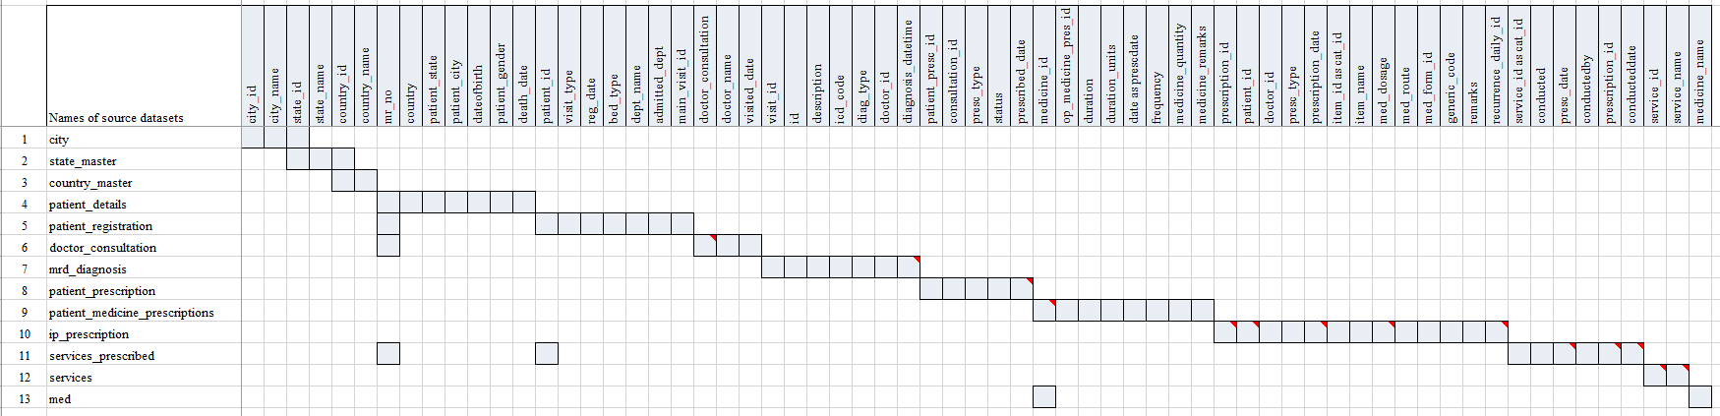
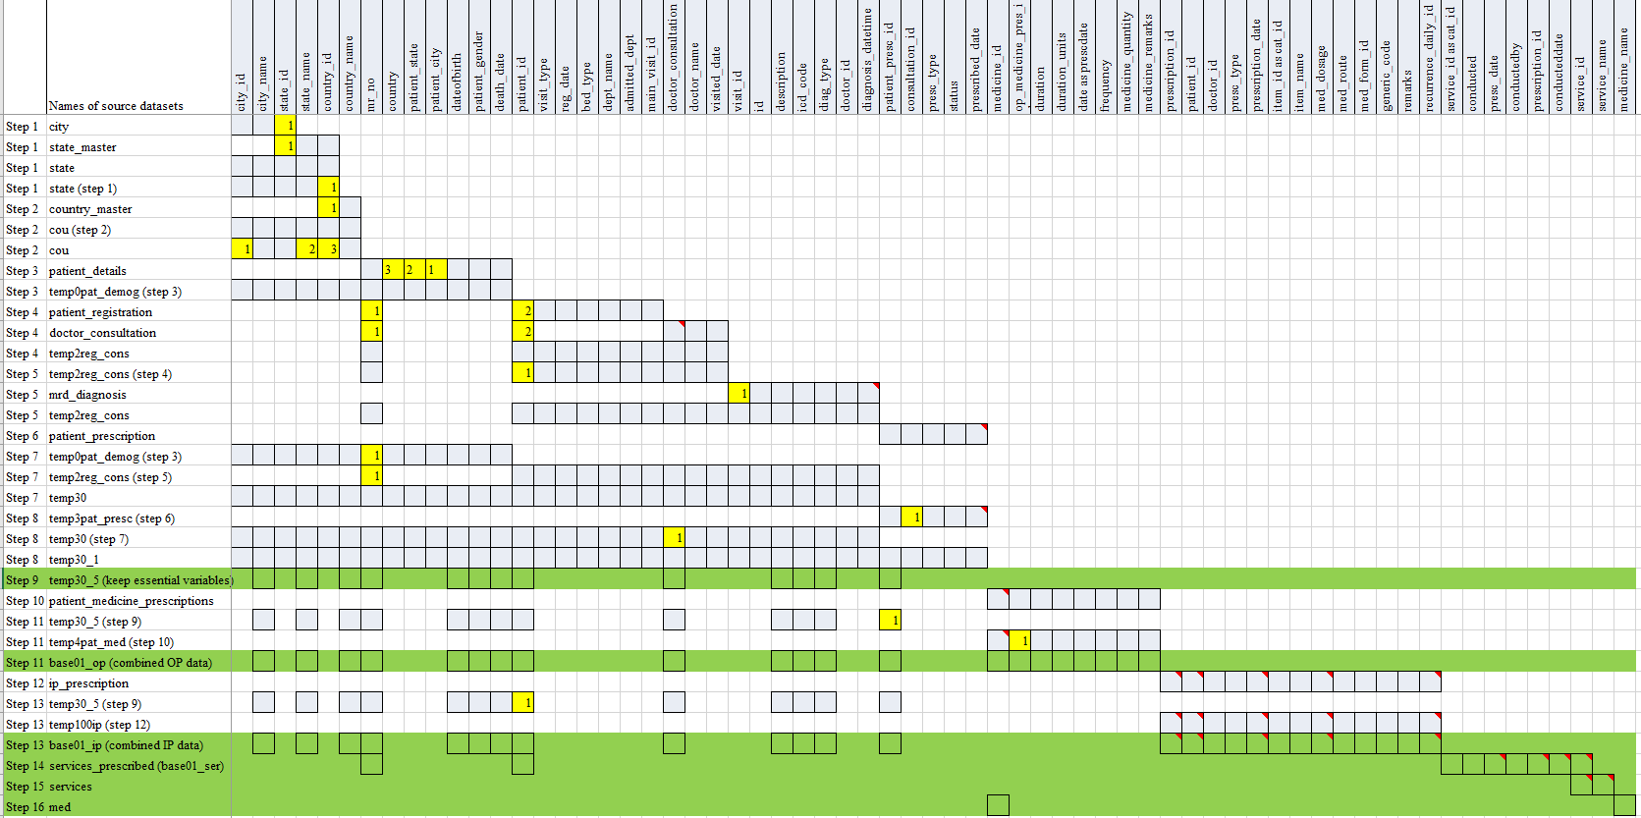
Flow of steps: from source data to analyzable format, 1 example

Slide 18
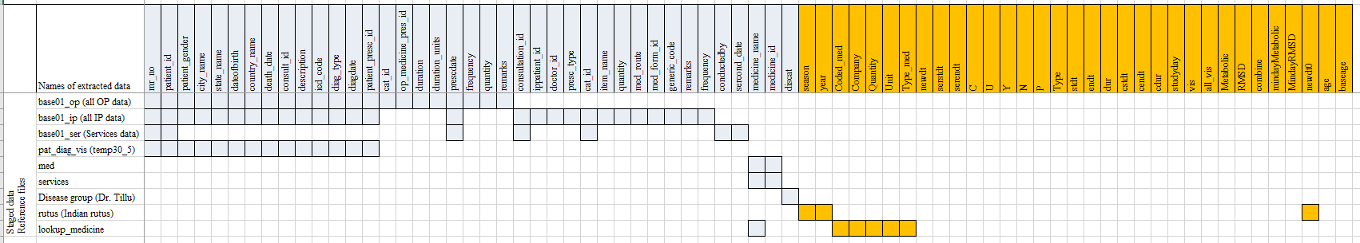
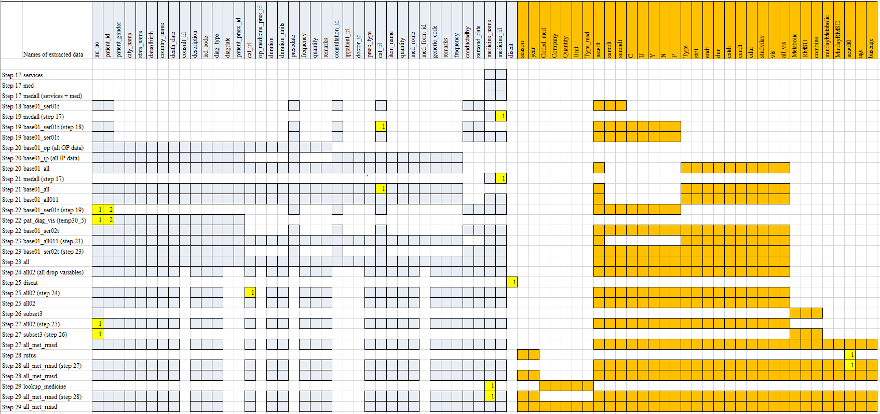
Flow of steps: from source data to analyzable format, 1 example

Slide 19
Summary of methods
Tabular representation using frequency counts
Descriptive summary statistics
Data representation on world / country map
Boxplot representation
Barplot representation
Dotplot representation
Radar plot representation
Individual patient level data listings
Various types of bubble plots
Circular data representation
Collapsible tree diagram
Treemap / mosaic plot
Butterfly plot
Area plot
Calendar plot

Slide 20
Top 15 diseases treated*
Data version: 2011 to Oct 2016
Disease | Grand Total | Female | Male
Vatavyadhi – Sandhigata vaata | 3577 | 2339 | 1238
Vatavyadhi | 2783 | 1507 | 1276
Vatavyadhi – Gridhrasee | 2034 | 1055 | 979
Vatavyadhi – Avabaahuka | 1482 | 865 | 617
Amlapitta | 1429 | 628 | 801
Prameha | 1375 | 585 | 790
Shvaasa | 1228 | 543 | 685
Netra Roga | 1120 | 516 | 604
Madhumeha | 1063 | 369 | 694
Staanabhedana Shoola – Katee Shoola | 978 | 494 | 484
Sthaulya | 831 | 487 | 344
Greeva Graha | 821 | 399 | 422
Kaasa | 814 | 410 | 404
Staanabhedana Graha – Katee Graha | 796 | 363 | 433
Kshudra Roga | 725 | 378 | 347
This preliminary analysis provides a lot of patients in Metabolic area and (Rheumatic and Musculoskeletal disease) RMSD area, hence major analysis will be carried out using these 2 disease areas
*: preliminary analysis was carried out by Dr. Girish Tillu.

Slide 21
Metabolic, Rheumatic and Musculoskeletal (RMSD) diseases
10 metabolic diseases
97 RMSD diseases
Large volumes of patients in the database

Slide 22
Results

Slide 23
Results – Clinical data understanding

Slide 24
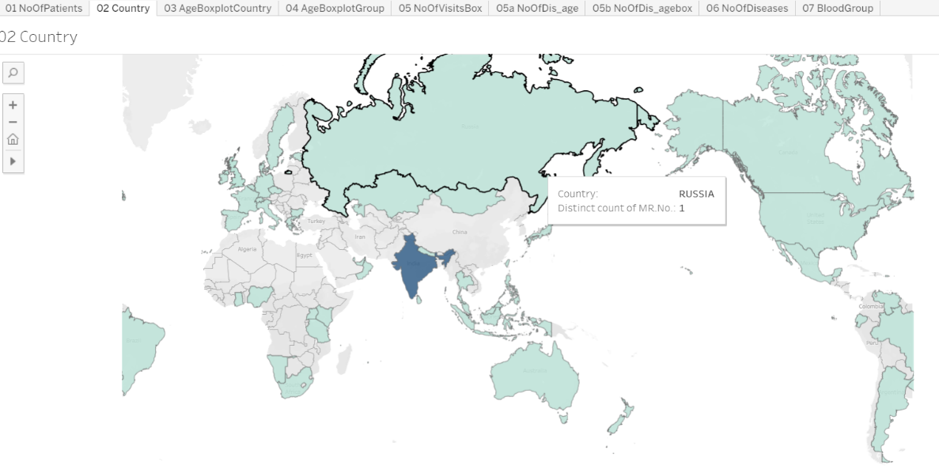
Patient analysis by country visualization on the world map
Data version: 2011 to Oct 2016
Interpretation:
This graphic shows the geographical distribution of patients.
In this version of the data, there are patients coming from 50+ different countries. 90% or more patients are from India and remaining 10% patients are from different parts of the world.
If the individual state and city information is available then additional drill down representation is possible – this supplementary pictorial will allow us to identify the distribution of patients and diseases from different parts of India.
Use for each stakeholders:
A pictorial representation of the world data, very useful as an executive summary. This form of data representation will help any public health official. More details related to diseases, treatments, additional demographic characteristics could be added to the tooltip to efficiently recover key information as and when needed.
https://public.tableau.com/views/04_patient_analysis_tablaeu/05bNoOfDis_agebox?:display_count=y&:origin=viz_share_link

Slide 25
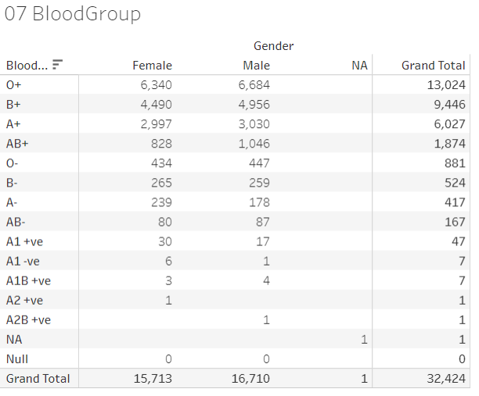
A tabular summary of Blood group distribution by gender
Data version: 2011 to Oct 2016
Interpretation and use for stakeholder:
Blood group distribution for such a large number of patients is a great source of knowledge. Even though this does not help in every day treatment options, there is undoubted epidemiological value in this tabulation.
There are obvious mistakes in documenting the blood groups observed via this tabulation – another secondary use of this tabulation to build data quality related efficiencies.
https://public.tableau.com/views/04_patient_analysis_tablaeu/05bNoOfDis_agebox?:display_count=y&:origin=viz_share_link

Slide 26
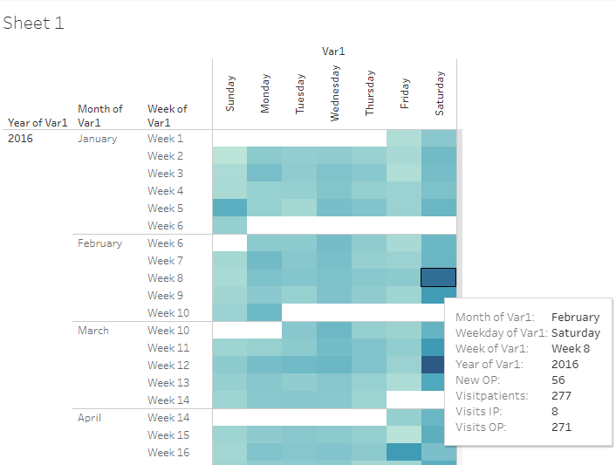
In-depth review of visit pattern analysis
Data version: 2011 to Oct 2016
Patients visiting on each day, details of visits displayed in the tooltip maximizing the usage of space
Supporting data to design availability of people on shifts on week days and week ends
Frequency counts of 4 parameters, (1) new Out-Patients added on that day, (2) total number of patients visiting on that day, (3) total number of In-Patient visits on that day, and (4) total number of Out-Patient visits on that day are calculated for each day to understand the patient flow to hospital from year on year. Light blue to dark blue shows increasing frequency count of number of patients. Link to analysis: Link
https://public.tableau.com/views/04_calendar_view/Sheet1?:display_count=y&:origin=viz_share_link

Slide 27
Results – Demographics and Patient specific factors

Slide 28
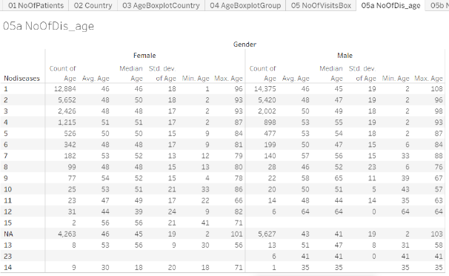
In-depth review of number of diseases
Data version: 2011 to Oct 2016
Interpretation:
Almost 12k+ and 14k+ patients with only a single disease, these patients could have come only once to the hospital and may not have come back at all after reporting the 1st disease. Are these patients largely coming in for “2nd opinion”? Or if this data is to be looked at positively, they are getting benefitted and hence are not coming back for consultation beyond the first reported disease?
The summary statistics for each of the category across number of diseases looks quite similar.
Patients having more than 10 disease conditions. These patients could be having a lot of faith in Ayurvedic treatment, for them to continue on, they could have found the underlying treatment effective. The maximum age of the 108 is a possible data issue. While finding data issue was not a primary outcome of the analysis, there is this secondary usage available to the scientific community. Similar anomalies are seen in a few other groups, e.g., patients reporting 23 diseases, is this accurate or needs additional data checks?
Use for the stakeholders:
Is there a similar tabulation available for another Ayurvedic hospital, or any other private or public hospital? Is there a similar distribution viewed? This can be used to understand the use and misuse of the limited medical sources across the geographies.
https://public.tableau.com/views/04_patient_analysis_tablaeu/05bNoOfDis_agebox?:display_count=y&:origin=viz_share_link

Slide 29
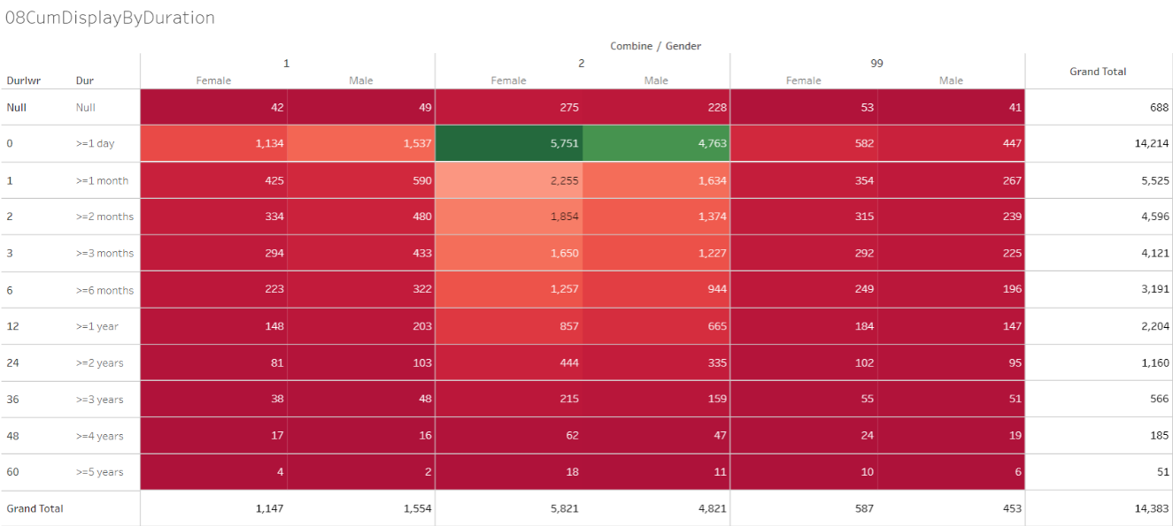
A tabular representation of Patient visit duration for Disease categories by Gender
Data version: 2011 to Oct 2016
Interpretation:
This summarizes the duration of the patient and hospital association for 14000+ patients
Patients from RMSD disease are more prevalent and ~15% patients visit the hospital after 1 year
~ 38% patients come to hospital for more than 1 month.
Smaller duration of patient and hospital association may mean either the patients are benefitted by the treatment or are not happy and hence discontinue the treatment.
Longer duration of association may mean that the patient is receiving benefit and hence is coming for regular follow-ups for the same condition or the disease condition could be chronic in nature.
More patients having reported at least one disease from each of the groups seem to continue for longer duration as compared to patients having either RMSD or metabolic diseases.
1 = Patients with at least 1 metabolic diseases, 2 = Patients with at least 1 Rheumatic, Musculoskeletal (RMSD) diseases, 99 = Patients with at least one disease from each of the groups
https://public.tableau.com/views/01RMSD_MET/01TotalPatRMSD_Metabolic?:display_count=y&:origin=viz_share_link

Slide 30
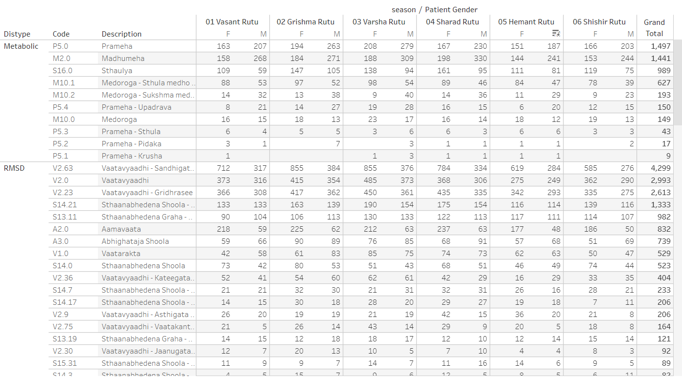
Seasonal Variations within Metabolic and RMSD disease areas by Indian rutus
Data version: 2011 to Oct 2017
Distype: Metabolic and RMSD, Code: ACD disease code, Description: disease description, seasons are presented as: Vasant rutu, Grishma rutu, Varsha rutu, Sharad rutu, Hemant rutu, and Shishir rutu. Link to analysis: Link
https://public.tableau.com/views/01SQL_Dis_Med_Ser/MedicineByDay?:display_count=y&:origin=viz_share_link

Slide 31
Results – Diagnostics and Interventions

Slide 32
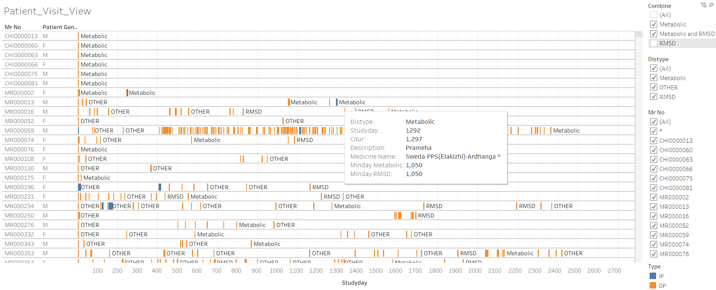
RMSD and Metabolic disease group
analysis – patient level data listing
Data version: 2011 to Oct 2017
Mr No: Patient ID, Patient gender, x-axis: duration of hospital visits, Orange bar: Out-patient visit, Blue bar: In-patient visit, Metabolic: when a metabolic disease is reported, RMSD: when a Rheumatic and Musculoskeletal disease is reported, OTHER: other diseases are reported. Patients listed have at least one of the RMSD or metabolic diseases. Tooltip has a lot of information relevant to each visit. Link to analysis: Link
https://public.tableau.com/views/01SQL_Dis_Med_Ser/MedicineByDay?:display_count=y&:origin=viz_share_link

Slide 33
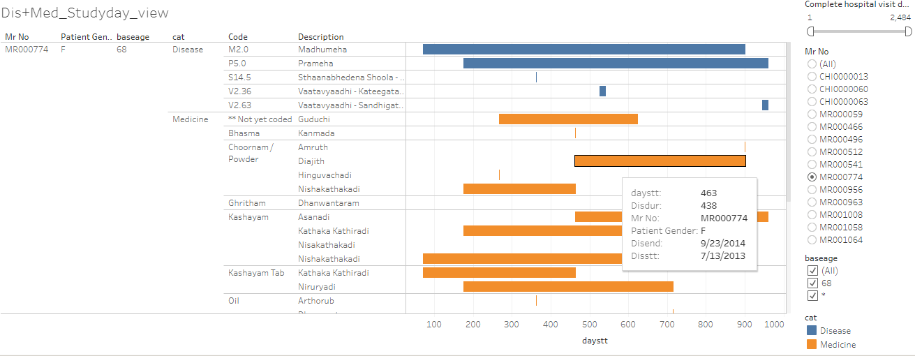
Patient profile view of individual patient by disease and medicine
Data version: 2011 to Oct 2017
Mr No: Patient ID, Patient gender, baseage Age at the very first hospital visit, category: Disease and medicine, Code: ACD code, Description: disease description, x-axis: duration of disease and medicine, Tooltip has a lot of information relevant to each visit. Link to analysis: Link to get the above display subset Mr No = MR000774
https://public.tableau.com/shared/HCSMCRXYP?:display_count=y&:origin=viz_share_link

Slide 34
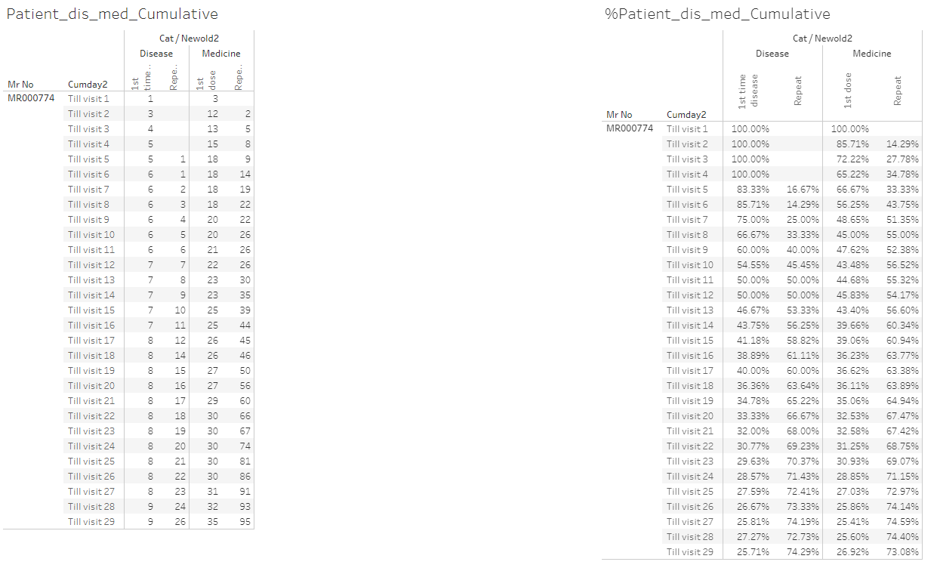
In-depth review of individual patient disease journey
Data version: 2011 to Oct 2017
The report displays individual patient data. Panel on the left hand: absolute values of diseases and prescribed treatments till particular visits, panel on the right hand side: % values of diseases and prescribed treatments till particular visits, Link to analysis: Link
080_medicine_dis_repeat_prop_cumulative | Tableau Public

Slide 35
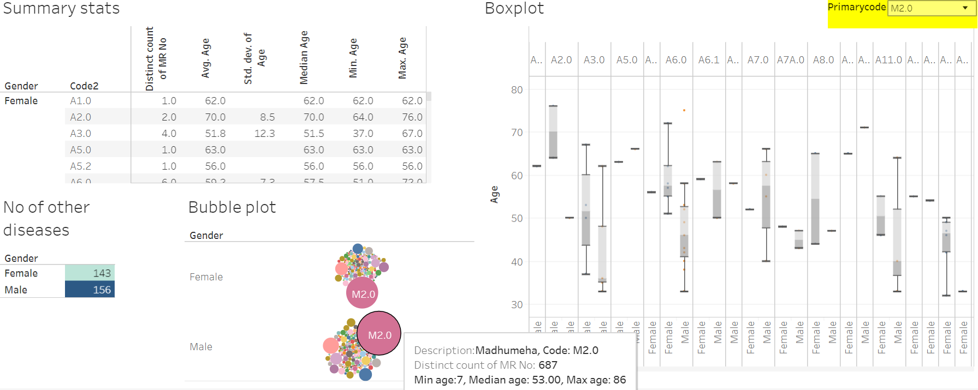
Co-morbidity analysis: Patients with Madhumeha and additional diseases reported
Data version: 2011 to Oct 2016
Summary stats section: descriptive statistics details by gender and other diseases reported, No of other disease: distinct number of other diseases reported by patients who had reported the primary disease, Bubble plot: frequency count of distinct patients by disease, Boxplot: age distribution by disease and gender. Link to analysis: Link to get the above display subset Primarycode = M2.0
https://public.tableau.com/views/Primary_disease_and_all_other_diseases/Dashboard2?:display_count=y&:origin=viz_share_link

Slide 36
Visit window table for Pre and post analysis
Before | After
Day 1 as reference
Before 1 month | Within 1 month
Before 2 months | Within 2 months
Before 3 to 6 months | Within 3 to 6 months
Before 7 to 12 months | Within 7 to 12 months
Before 2nd year | Within 2nd year
Before 3rd year | Within 3rd year
Before 4th year | Within 4th year
Before 5 year | Within 5 year
The following analysis used first occurrence of any disease as day 1 for an individual patient. Using this as a reference day “before period” and “after period” was derived.
“Before period” provides significant amount of “baseline data”,
“after period” provides specific insights into what would happen after the onset of the reference disease.

Slide 37
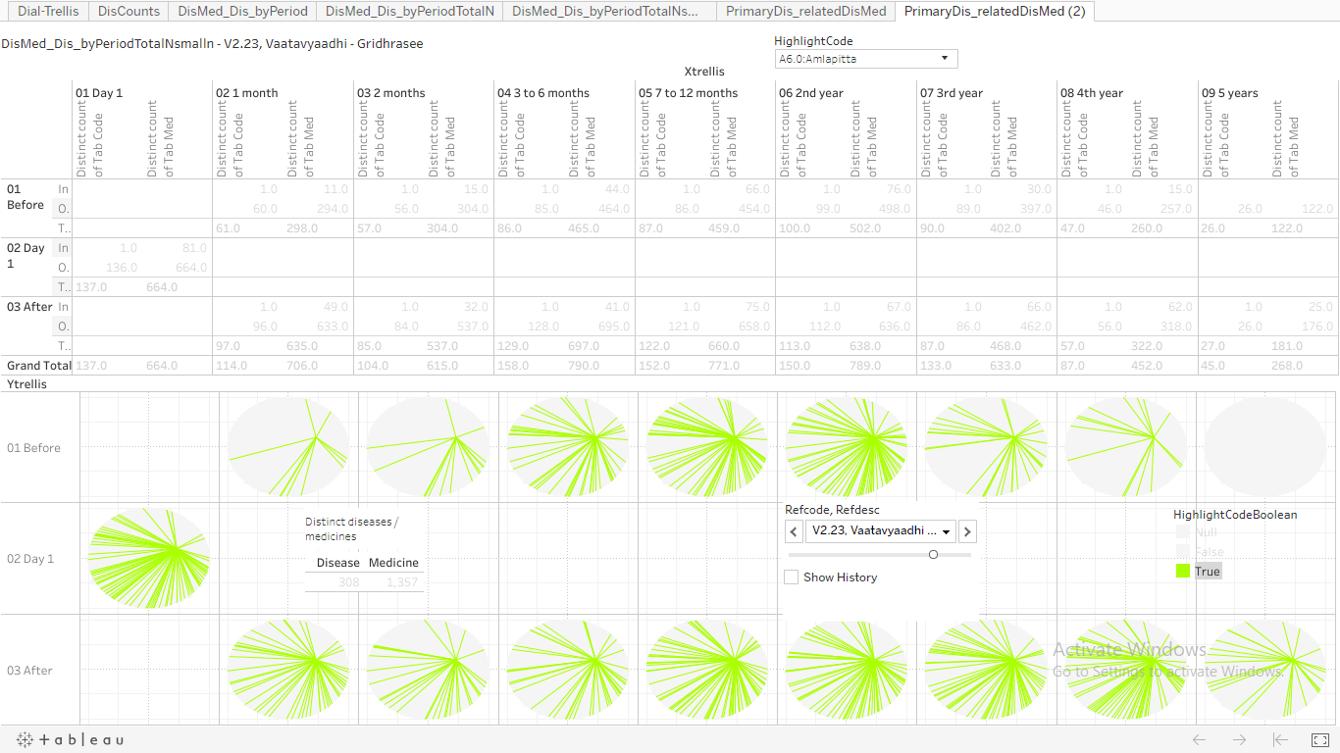
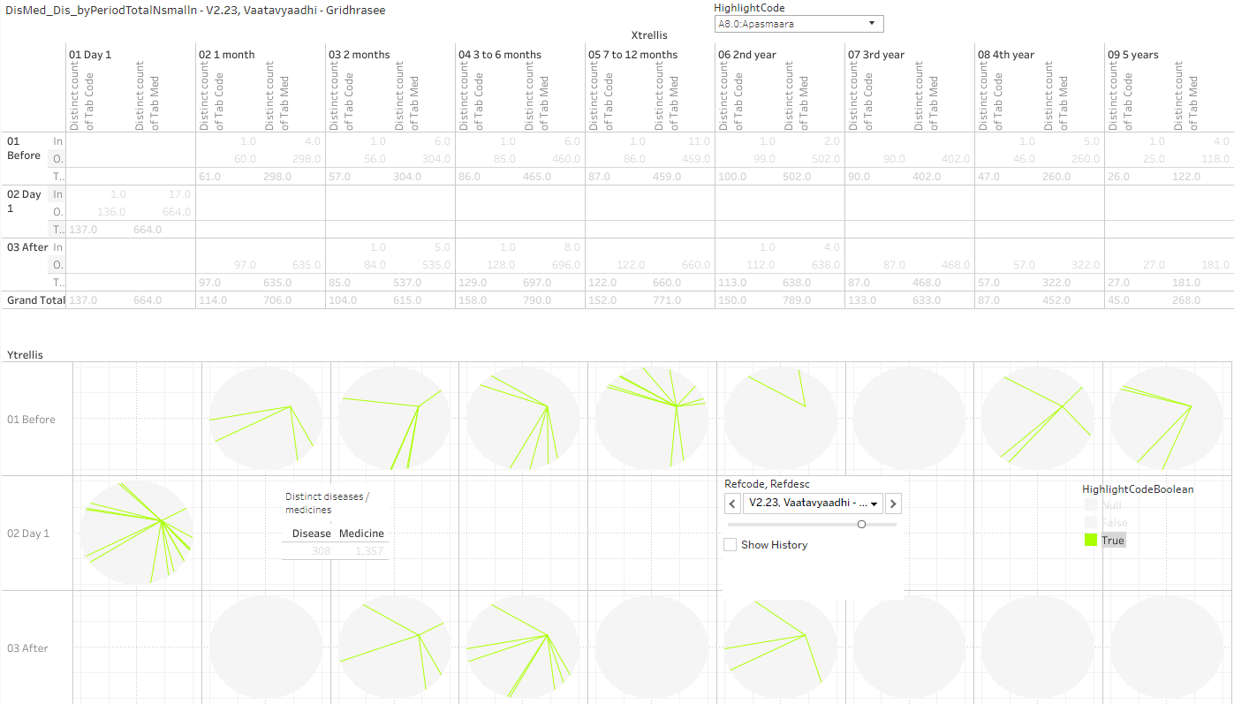
Circular view representation of disease and medicine co-occurrences, pre and post
Data version: 2011 to Oct 2017
Combination of reference disease “V2.23: Vaatavyadhi – Gridhrasee” and disease “A6.0: Amlapitta”.
Interpretation, Many green lines means:
There is a greater chance of diseases reported by patients
There is a greater chance of a medicine prescribed for a disease
Visualization of
Co-occurrences of disease and medicine
Co-occurrences of disease and disease
https://public.tableau.com/views/085_dis_count_edges_3rd_byPeriod02try/PrimaryDis_relatedDisMed2?:display_count=y&:origin=viz_share_link

Slide 38
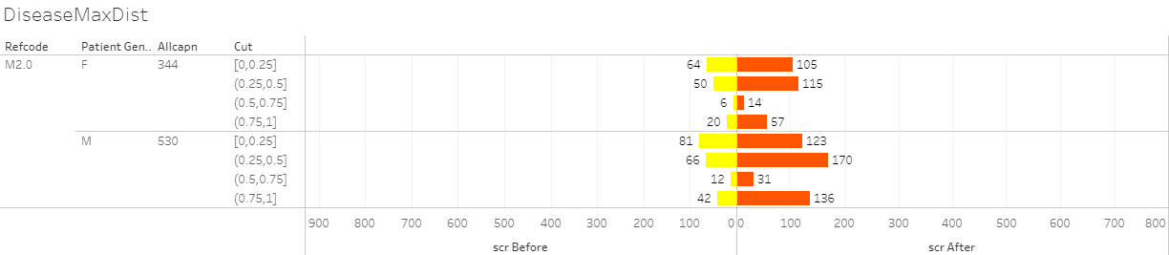
RMSD and Metabolic disease group analysis
Pre and Post analysis for disease – Example Madhumeha
Data version: 2011 to Oct 2017
Butterfly plot display of pre and post distance analysis for disease trajectories. Refcode: reference disease, Patient gender, Allcapn: Total number of patients in each of the categories, Cut: Jaccard distance, scr Before: patients falling in a particular category before day 1 of reference disease, scr After: patients falling in a particular category after day 1 of reference disease. Link to analysis: Link to get the above display subset Refcode = M2.0
Disease trajectories are calculated as diseases reported chronologically for each reference disease
Pre-disease trajectory
Post-disease trajectory
Compare all trajectories using a mathematical distance (example used: Jaccard distance)
Find the most similar distance Pre and Post
0: least similar, 1: most similar
Plot these as 0-0.25, 0.25-0.5, 0.5-0.75, 0.75-1
https://public.tableau.com/views/DistanceMeasuresTimePeriod-086prgm/DiseaseMaxDist?:display_count=y&:origin=viz_share_link

Slide 39
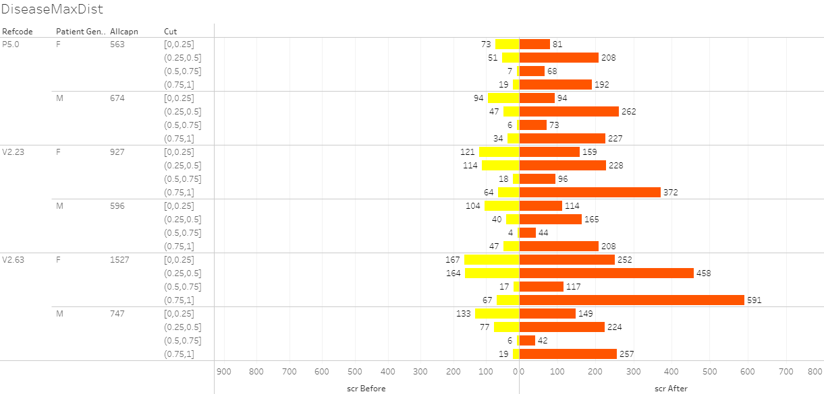
RMSD and Metabolic disease group analysis
Pre and Post analysis for medicine
Data version: 2011 to Oct 2017
Butterfly plot display of pre and post distance analysis for medicine trajectories. Refcode: reference disease, Patient gender, Allcapn: Total number of patients in each of the categories, Cut: Jaccard distance, scr Before: patients falling in a particular category before day 1 of reference disease, scr After: patients falling in a particular category after day 1 of reference disease. This distance calculation was done on the basis of trajectory of prescribed treatments. Link to analysis: Link to get the above display subset for Refcode in (P5.0, V2.23, V2.63)
https://public.tableau.com/views/DistanceMeasures-Medicines/MedicineMaxDist?:display_count=y&:origin=viz_share_link

Slide 40
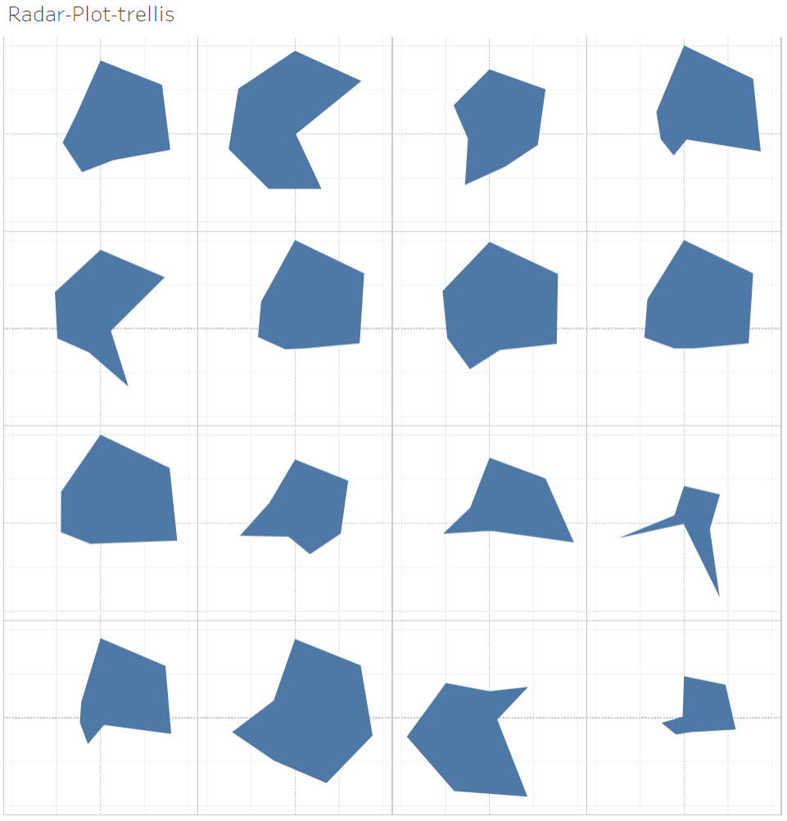
Radar plot: visualize many parameters of a disease to see similarity / dis-similarity
Data version: 2011 to Oct 2017
Each disease is visualized as a percentile for the following parameters:
Distinct number of patients
Number of times a disease is reported
Number for a specific disease (chronological number of disease reported by a patient)
Number of diseases before the specific disease
Number of diseases after the specific disease
Number of treatments before the specific disease
Number of treatments after the specific disease
A heptagon visualizes a disease
Differing shapes provide differences reported in the data
https://public.tableau.com/views/300_radar_plot/Radar-Plot-trellis?:display_count=y&:origin=viz_share_link
https://github.com/coursephd/PostgreSQL/blob/master/300_radar_plot_tableu.R

Slide 41
Conclusions

Slide 42
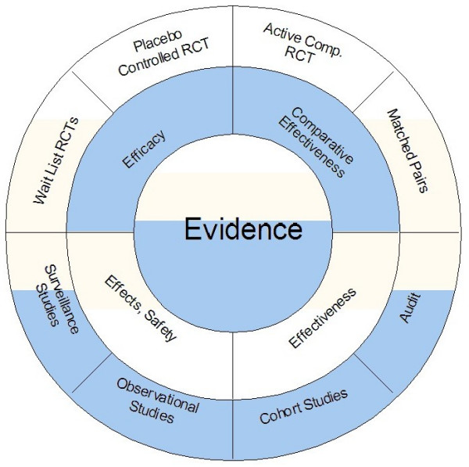
Evidence: Proposed Approach
Real world
Clinical practice data analysis
As of 2020:
4.5 lakhs registered ayurvedic practitioners
5% = 22,500 doctors
2 new patients / day
225 working days / year
Potential of 50 lakh patient data / year
EMR solution
Walach H et al. BMC Med Res Methodol. 2006, 6:29, AYUSH website

Slide 43
How does this study help?
Clinical operations:
Operational efficiencies
R&D:
Automated documentation for regulatory / audit needs
Clinical decision support
Reproducible research
Public health:
Patterns of diseases and medicines
Disease surveillance
Population health management
Data to actionable information
Evidence based medicine:
Empirical evidence
Nature and context of disease
Analysis of clinical practice data
New needs:
New needs never thought of in ayurvedic area so far*
Much more than excel subsets / pivot tables ...
Complex computing
Advanced visualizations -- A picture is worth a thousand words
Pioneering effort and new contributions: as this kind of work was never done in ayurvedic area
*: our assumption, as no one has seen anything like this before within Ayurveda data analysis

Slide 44
Questions (1/2)
Hospital management | Regulatory / insurance | Teaching / PhD / MD
Number of patients Patient characteristics % of males / females The age groups Countries, states, cities Number of visits Visit patterns Number of In / Out Patients Assessments done at visit Overall duration of visits Reported diseases Number of diseases Operational insights Pharmacy | Evidence base generation (EBM): integration of best research evidence with clinical expertise, patient and parents’ preferences Use these data as “secondary use” Labels of medicines and prescriptions in the database match each other Metal based treatments and related discussions Initiation of “Ayurvedic registry” Cost per visit | Data as a supplementary material for PhD / MD Data: as an additional teaching material for college students Rare disease identification Cohort generation: Understand the natural history What is the meaning of cohort in ayurvedic area? Predict any questions, trajectory of diseases, etc. Predicting the next complication or next disease, when and what? Quantifying the effect of intervention Construct evidence based guidelines

Slide 45
Questions (2/2)
Clinical practitioners | Publications / Research proposals | General public / popular articles
Individual patient data and how are the treatments prescribed Diseases differences in gender, season, age group Disease – disease combination Higher / lower diseases and natural occurrences Prescription of treatments | Data backed proposals for research grants Case report / series generation for publication Validation of Ayurvedic treatment protocols In absence of “hard clinical end point” short term outcomes (intent adherence to the treatment) intermediate term outcomes (actual adhere) long term outcomes (overall health) Longitudinal / epidemiologic view Pre and post analysis Co-morbidity analysis | Weekly communications in local / national papers Simple short stories to build image of Ayurveda Based on the seasonal diseases, provide simple preventive measures

Slide 46
Statistical programming / Clinical programming / Ayurdata expert*
Statistical programmers play a key role in
turning the data into knowledge and
supporting the development of new medicines
Statistical programmer
Converts raw data to analyzable data
Performs data checks
Creates Tables, Listings, Figures (visualizations)
Customizes the data to produce an output which displays the behavior of the data
Inference of the data is done using the TFLs
Not an IT profressional
Not just a statistician
Not a data manager (cleaning the data)
Not a database developer to store the data
Uses IT systems
Uses statistician’s mind
Provides insights into building database
Scientific rigor
Uses multiple technologies
Uses ideas to convert
An observation to summaries to Stories
Clinical insights w/o being a doctor
Pioneering effort and new contributions: as this kind of work was never done in ayurvedic area
*: new skill

Slide 47
Benefits
The database will be useful in publishing case studies, case series, etc. in a short period of time. This will help us gain more visibility in scientific world
The database will become more searchable
More empirical data will be available at our disposal
The data will be closer to analysis ready format
The database could become a model database for other Ayurvedic institutions to follow

Slide 48
Data to knowledge to Wisdom

Slide 49
Ongoing / future work
Work with the university and hospital management for updates to the data capture process,
Attempt to work with other hospitals and carry out similar analysis,
Use Sequential Pattern Mining library developed by Phillipe Fournier-Viger, having more than 100 algorithms to discover patterns in data,
Use Co-morbidity package in R programming language to identify disease comorbidities using different statistical tests and metrics,
Use Natural Language Processing approaches using tensor flow methodologies to discover underlying patterns in the data,
Work with the ayurvedic physicians in the hospital on specific disease areas like Chronic Kidney Disease (CKD), and Parkinson disease data – these are the areas, hospital is working actively working on
Latest addition as of 2023: use of ChatGPT type of approach within ayurvedic area

Slide 50
Thank you’s
Ashwini Mathur
Ashwini Godbole
Girish Tillu
Poornima Devkumar
Prasan Shankar
Darshan Shankar
Ravi Kumar G
Vivek Sanker
Sriranjini
TDU IT team
Last but not the least family

